Slide 1


BOOTCAMP TRAINING - IDA
Week 7 Report
-Neha Juyal

Slide 2
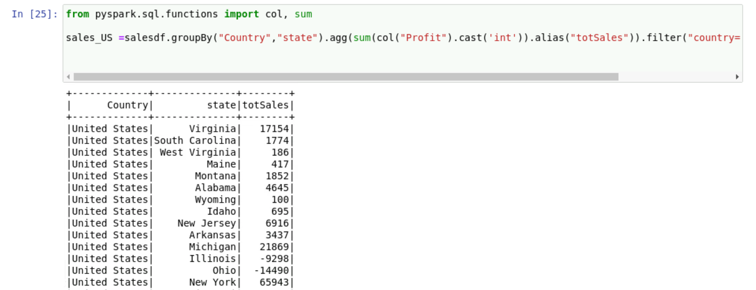
Day – 1 Pyspark
Followings were the learning of Day 1:
Commands on aggregate, alias and filter

Slide 3
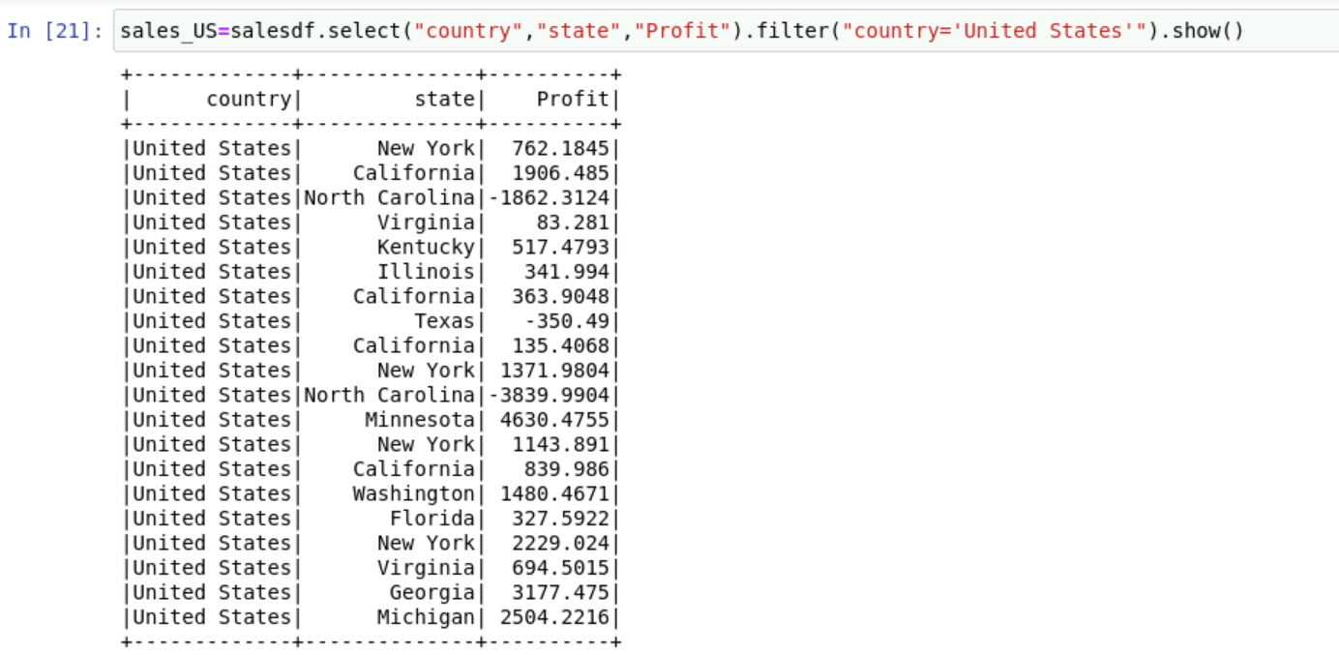

Slide 4
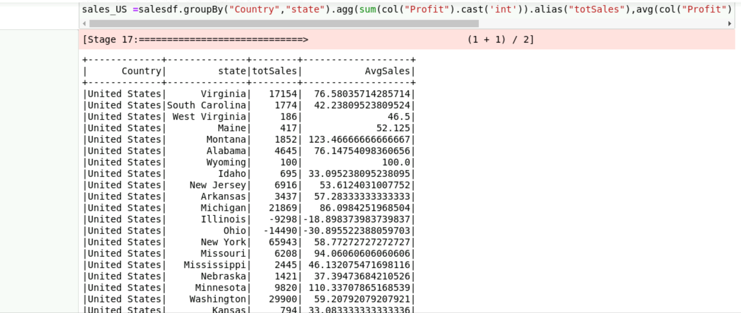

Slide 5
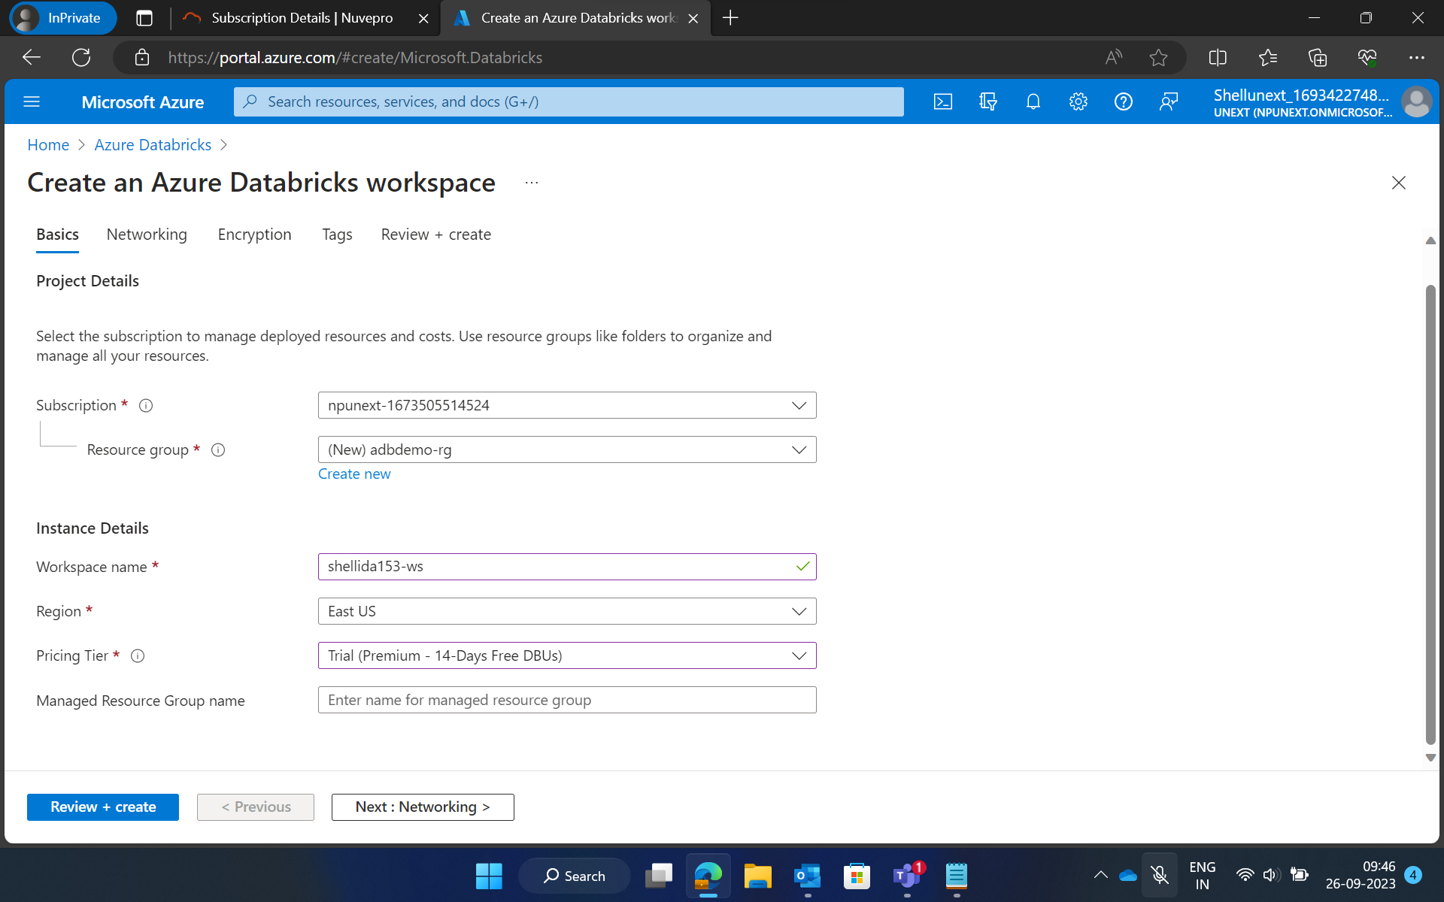
Day – 2 Azure Databricks

Slide 6
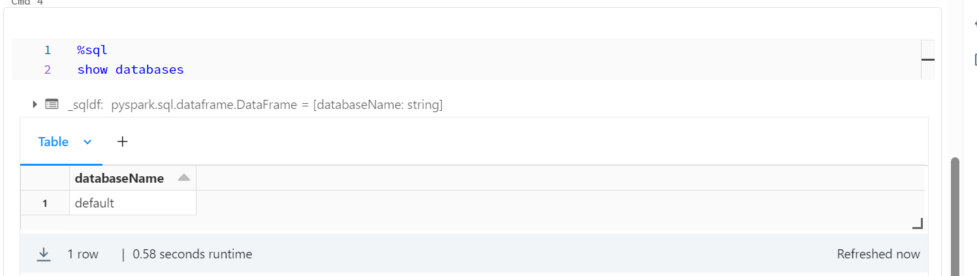

Slide 7
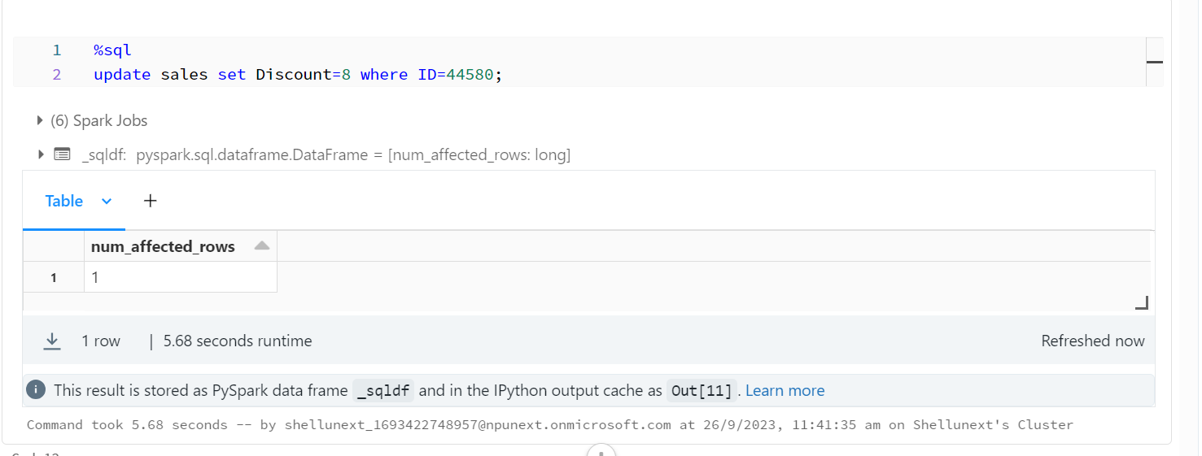

Slide 8
